Slide 1
Sarcasm Detection using Emojis and Sentiment Analysis on Play Store App Tweets
SIRAJAHAMED N D PES1201701496
AJEYA B S PES1201701604
AMRUTH KARNAM PES1201700266

Slide 2
Objectives
Sarcasm detection on tweets with emojis
Sarcasm Labels provided along with tweets
So, accuracy and f1 score detected by comparing the training results with the labels.
Sentiment analysis on Play Store App tweets
Sentiment label provided with the tweets
Sentiment polarity output decides the sentiment.
Accuracy found by comparing with labels

Slide 3
Path followed
For Sarcasm Detection: For App Sentiment Analysis:
1) Dataset 1) Dataset
2)Literature Review 2)Literature Review
3)Preprocessing 3) Preprocessing
4)RNN Model -Bi- LSTM model tried 4) Representations - Graphs
5) Attention model 5) TextBlob
6) Hybrid model combining BiLSTM and Attention

Slide 4
Literature Review
https://www.aclweb.org/anthology/O18-1021.pdf
Jenq-Haur Wang et al. mention how RNN might lead a vanishing weight or exploding weights problem, and hence suggest for an approach where Word Embedding should be followed by LSTM for a better result.
https://pdfs.semanticscholar.org/1baa/3f4fda7c92600a5c192adaed80a834d13ff9.pdf
Jeffrey Pennington et al. explain how GloVe Model works , how it is a term-term matrix rather than a term-document matrix, and shows how it performs better than other baseline models like Word2Vec
https://www.aclweb.org/anthology/Y14-1047.pdf
Piyoros Tungthamthiti et al. use SVM approach for sarcasm detection. But even with tri gram models which is the highest value of n taken, they arrive at 79% accuracy, and in their limitations, they say they could not handle words with #. So that provides an idea of removing hashtag from our data.

Slide 5
4)https://pdfs.semanticscholar.org/7ac1/e870f767b7d51978e5096c98699f764932ca.pdf
C. Du, L. Huang explains how Attention captures the best of both - keyword classification and neural network classification, as Attention assigns higher weight to some words compared to others. We are talking in the context of Soft Attention here, as Hard Attention would be focussed on one feature and it would be non deterministic.
5) https://arxiv.org/pdf/1711.10377.pdf
Hamid Bagheri and Md Johirul Islam use Textblob as well for their sentiment analysis of twitter data
6) https://www.researchgate.net/publication/273127322_Preprocessing_Techniques_for_Text_Mining
Vairaprakash Guruswamy and Subbu Kannan mention the well-known preprocessing techniques for text mining. They mention the importance of preprocessing techniques like stop word removal, stemming, tokenization, which leads to the computer getting better data for processing from the previous unstructured data.

Slide 6
Datasets
Problems faced :
Very less datasets in sarcasm detection having labels of sarcasm, and having Twitter Data, and having emojis and in a single domain.
So, we chose to skip the single domain constraint
No reliable dataset with emoji tweets having sentiment labels
Same tweet copied in one such dataset, The same smiley appended to all tweets in another.
So, we chose to do sentiment analysis on play store app tweets.
Dataset for Sarcasm Detection - Github
Data taken from the link : https://github.com/jsubram/Sarcasm-Detection-Using-Emoji/tree/master/Data
Dataset for Sentiment Analysis- Kaggle
UserReviews.csv taken from the link : https://www.kaggle.com/saiamogh/google-play-store-analysis/data

Slide 7
Classifiers used
For Sarcasm Detection:
RNN - LSTM Model
Attention Model - Soft Attention, as activation used is differentiable
Attention model built on top of Bi-LSTM Model
For Sentiment Analysis:
TextBlob

Slide 8
Performance of classifiers - Metrics
Metric for evaluation : Accuracy and F1-Score
For Sarcasm Detection
(Previously, with RNN, we were getting 68%, the code scrapped)
With only LSTM - 84% accuracy , 80% training F1 Score, 83% validation F1 Score
With Hybrid - LSTM + Attention - 97% accuracy, 93% training F1 Score , 96% validation F1 Score
For Sentiment Analysis
With TextBlob - 85% accuracy, 80% F1 Score

Slide 9
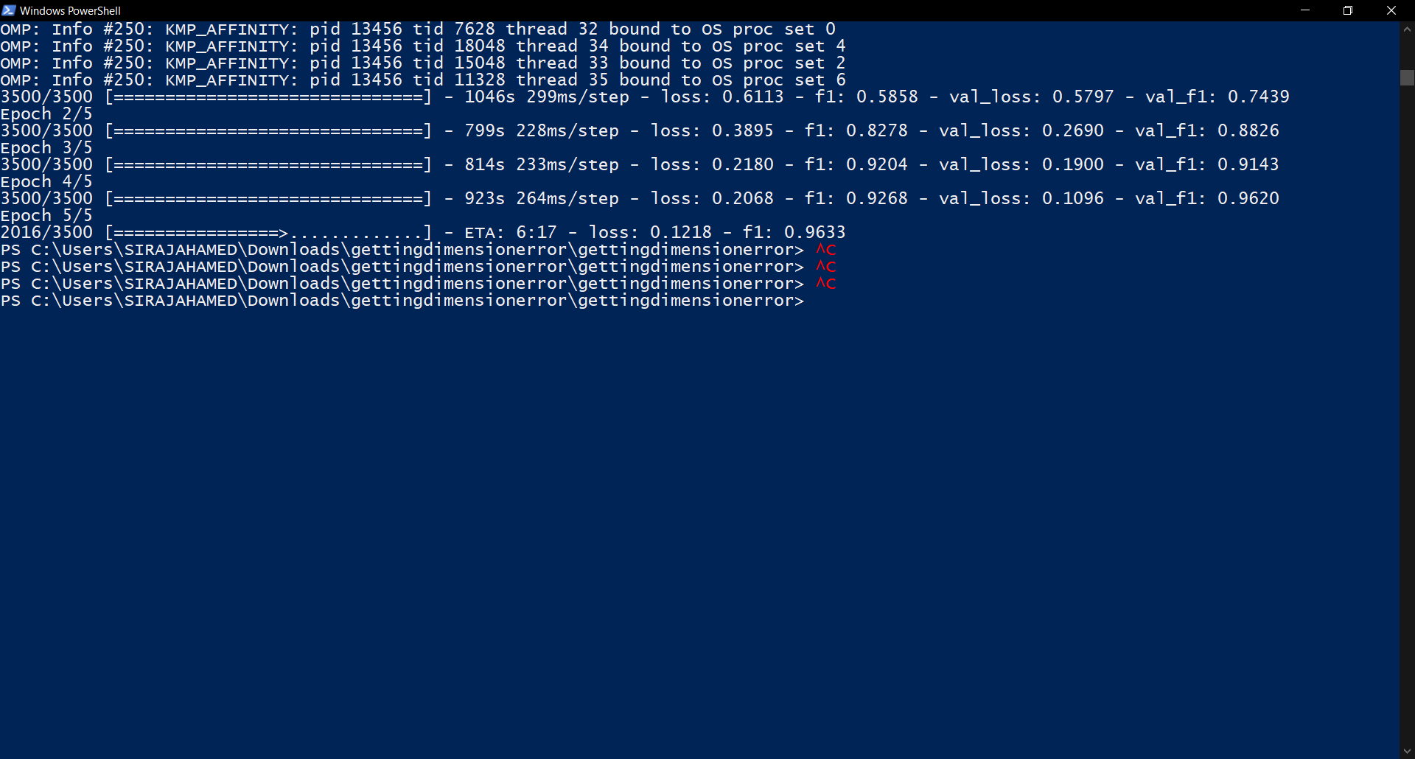
Bi LSTM + Attention

Slide 10
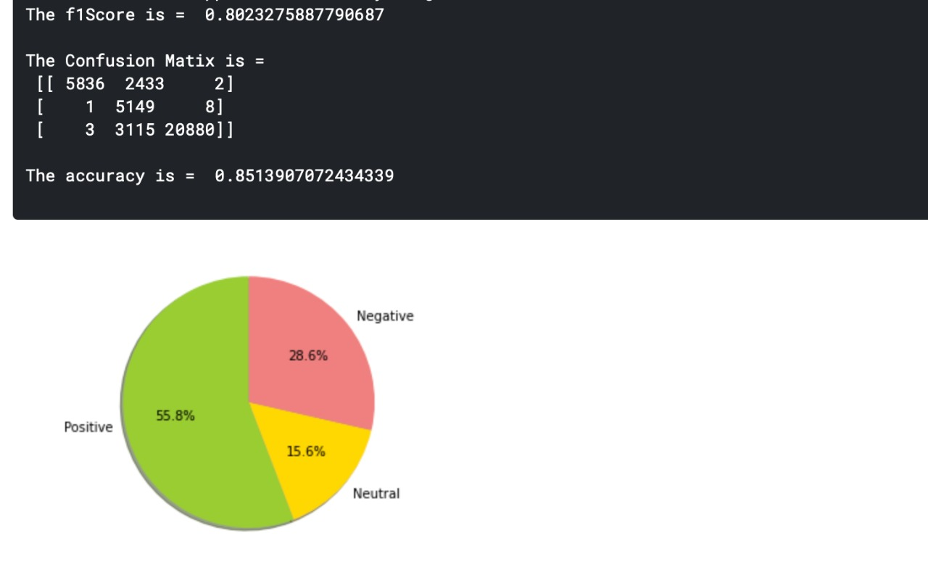
Sentiment Analysis -
TextBlob

Slide 11
Novelty of our work
For Sarcasm detection :
Among many projects we found, very few people had done any preprocessing, only basic preprocessing was done.
We have made sure that proper preprocessing is done to our data which we think led to better results.
Many of the projects we saw only had implemented only LSTM. From assignments, we got an idea to implement BiLSTM, and subsequently we found a GitHub repository which had an empty Attention class which led us to research Attention and implement it which led to a better accuracy.
For Sentiment Analysis:
Many projects had mentioned the use of algorithms like K Means, FCM . But from the assignments , we found that with TextBlob library, and the functionalities it provides like the classification algorithms, POS tagging and others.
And thus we used TextBlob library for our sentiment analysis, which led to a good result.

Slide 12
Thank You

